Slide 1
Mathematics revision session
9th January 2020
Students: Please login to your school account and open chrome. Go onto the mathswatch website: vle.mathswatch.co.uk/vle/. Login if you can.
Otherwise, use the following login details:
Username: 0001@stgcc
Password: Triangle

Slide 2
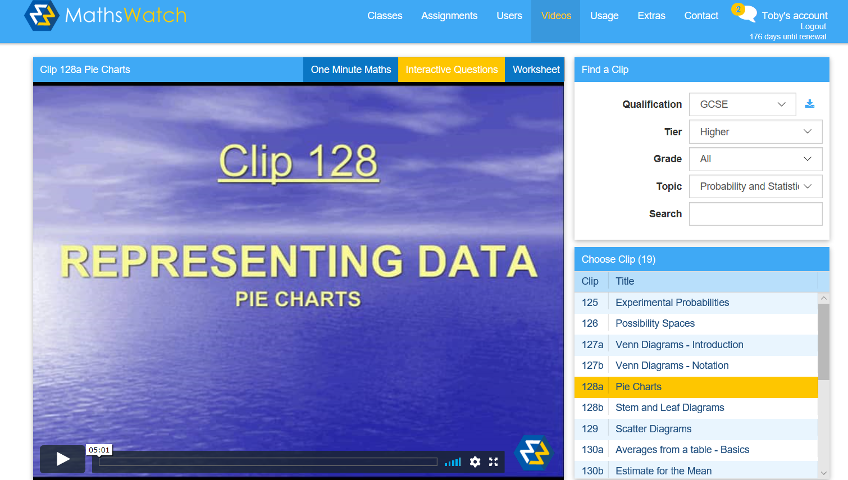
Mathswatch – YouTube for maths
Online video bank
Worksheets for each video
One Minute Maths
Foundation and Higher

Slide 3
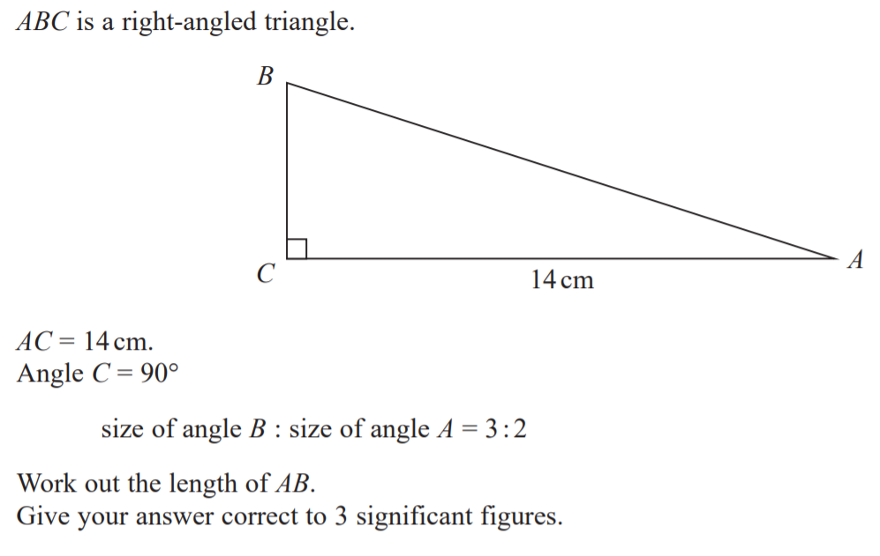
What do I need to Revise?
Topics in class
  Have you been absent from school?
  Do you need more time compared to the rest of the class?
  Could you do more work building on what you have learned?
Revision of Old Topics
  Gaps in your knowledge
  Inability to recall knowledge in class
The onus is on YOU

Slide 4
Your Turn
The onus is on YOU
What topics have you done recently in class (use your planner?)
What topics do you know you need to revise
How could you find out more topics that you need to go over?

Slide 5
Your Turn
Videos Section
Choose the topic required
Video
1 minute video
Worksheet
Check:
Mathswatch 9-1 worksheets solutions

Slide 6
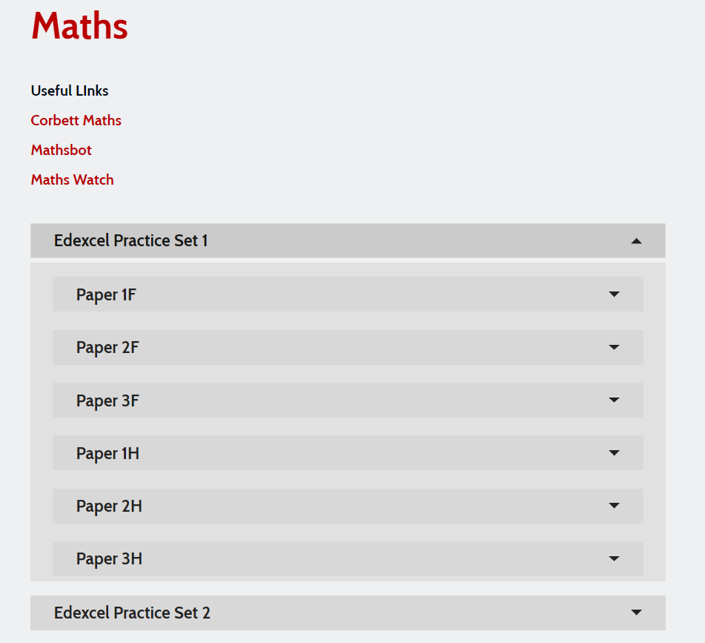
School website – “I have no maths homework”
Edexcel Practice Papers
Mark Schemes
Model Solutions

Slide 7
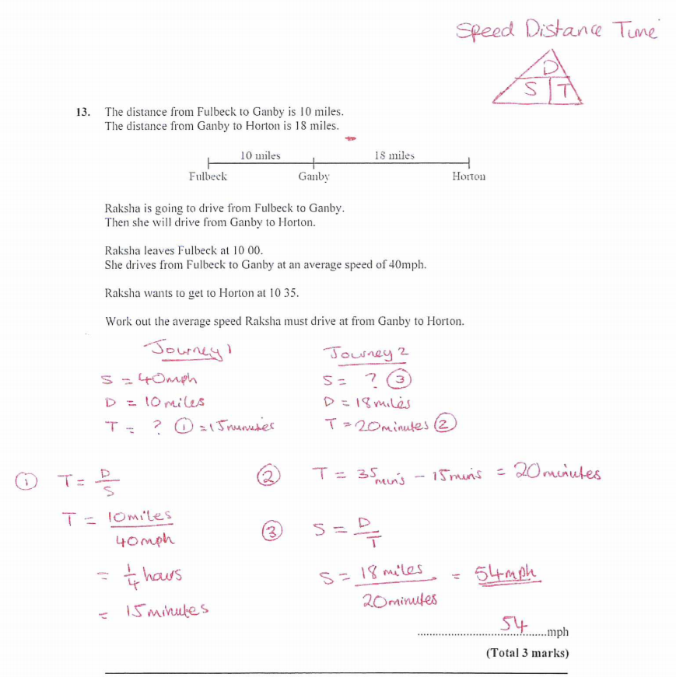
School website – “I have no maths homework”
Edexcel Practice Papers
Mark Schemes
Model Solutions

