Slide 1
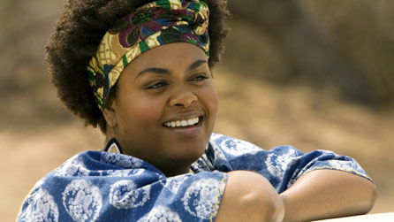
Mma Ramostwe
The No. 1 Ladies' Detective Agency is a series of crime fiction books by Alexander McCall Smith set in Botswana and featuring the character Mma Precious Ramotswe. Mme is the main character in these series. She was Botswana's first woman detective. Mme moved to Gaborone at the age of 34, using her fathers inheritance to buy a house and an office. Mma Precious Ramotswe solves cases for wives whose husbands have gone missing, for a school teacher whose son has disappeared by finding the kidnappers, for a wealthy father whose 16-year-old daughter is frustrating him by going out on her own.

Slide 2
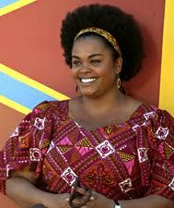
Key Details about Mma
Themes and topics of the stories
Women in non-traditional jobs and feminism
Rural way of life in southern Africa
Social relations in traditional African society
Christianity and traditional belief
Emotional intelligence
Craftsmanship and mechanics
Issues addressed in the cases
Domestic violence
Forgiveness
Gender equality

Slide 3
Description
When I heard a knocking on my door, I immediately rushed to open it. I already knew that it would be Detective Ramotswe. When I tilted the door ajar, I realised I wasn’t wrong. Infront of me, stood the woman herself, Botswana's recent phenomenon. Mma stood Infront of me, and it only took one glace at her soft but determined face to make me sure that she will help me solve all my problems. She was dressed in rather casual clothes; she had a dark blue sweater on, denim jeans and posh, lather boots. Mma’s hair was an afro, it was neatly pinned up using a golden hair clip that shone when sunbeams hit it. She had soft hazel eyes that looked like melted chocolate. Her skin was brown, delicate and soft. She smelled sweet, as if someone put a million flowers into a perfume bottle and sprayed it over her. When she spoke, her voice was calm and reassuring. Now I knew what the fuss was about. I hoped she would solve my case.

Slide 4
WWW:
Really detailed work- I have loved finding out about Mma, I had never heard of this character or this series before! Have you read any of them?
Beautiful imagery created in your description, great range of effective vocabulary and figurative language!
EBI:
Can you vary your sentence starters in your description? Consider using ISPACE to help you with this!
How does your character feel having just come face to face with this woman? Describe this through 'show not tell'.

