Slide 1
2.2 SPORT PSYCHOLOGY
2.2.5 Mental Preparation

Slide 2
Title: Mental Preparation
Learning Outcomes:
4-6: To be able to identify and describe the different mental preparation techniques.
6-7: To be able to explain the different mental preparation techniques and relate to sporting examples.
8 -9: To link the different mental preparation techniques and justify why they would be used for different sports.
Planner Topic: Mental Preparation
Starter; Pick 3 sports and think about how each could mentally prepare.

Slide 3
Tier 2 Word: Execution
What is the definition of skill execution?

Slide 4
Metal Preparation
Used prior to a race, game, performance or competition. The idea is for the performer to get their mind in the right place psychologically before they begin. The more they are practiced the more effective they will become.
There are four main techniques:
Imagery
Mental Rehearsal
Selective Attention
Positive Thinking
Use the mind map worksheet to complete information about the four techniques.

Slide 5
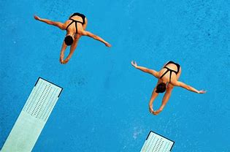
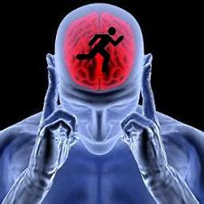
Imagery
Used to combat stress, pressure and nerves.
Being nervous is natural however it can lead to poor performance, your body behaves differently when under stress.
Involves performers imagining themselves in a relaxed place where they feel comfortable and calm in the moments before a performance. They could imagine they are on their own and no one is watching.
The effect of imagery decreases heart rate, allows the performer to feel calmer, more in control and able to focus on performance.
Extension: List 3 sports that could use imagery.
Challenge: Justify why your chosen sports would benefit from imagery.

Slide 6
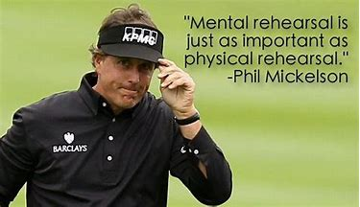
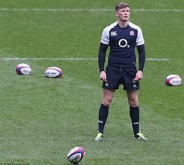
Mental Rehearsal
Used as a mental trial run of a skill, to remind the performer of key technical points that lead to success.
Involves a performer practising a skill in their head before physically executing it. It gives them a chance to practise a movement when physically practising isn’t allowed.
The effect of mental rehearsal increase their focus and ensures that their skill execution is consistent.
Extension: List 3 sports that could use mental rehearsal – be specific with the skill!
Challenge: Justify why your chosen sports would benefit from mental rehearsal.

Slide 7
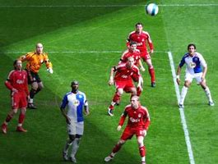
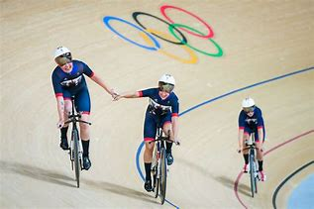
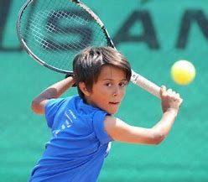
Selective Attention
Used as a way to block noise or distractions during performance.
Involves actively blocking out distractions and focusing all concentration on the performance ahead.
The effect of selective attention is the performer being in the zone and more likely to perform the skills effectively that we lead to success.
Extension: List 3 sports that could use selective attention – Be specific!!
Challenge: Justify why your chosen sports would benefit from selective attention.

Slide 8
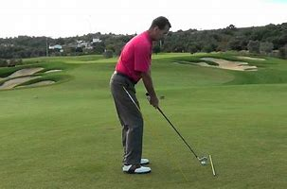
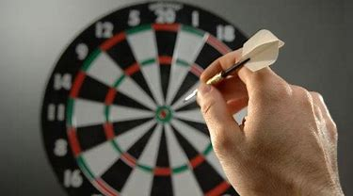
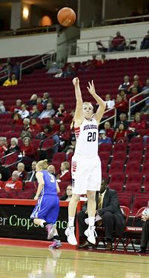
Positive Thinking
Used as a confidence boost, I ‘can do’ attitude and approach.
Negative self-talk is when you can start to doubt you ability just before taking on a challenging task. Allowing negative thoughts can distract you, upset your focus resulting in performing poorly.
Involves positive self-talk, performers talk to themselves either in their head or out loud as a way of blocking negative self-talk.
The effect of positive thinking increases a performers confidence of performing a skill and an improved execution.
Extension: List 3 sports that could use positive thinking.
Challenge: Justify why your chosen sports would benefit from positive thinking.

Slide 9
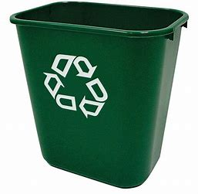
Lets give it a go…
Screw up your bit of paper…
You have 3 attempts to throw it in the bin to get used to it …
Half the class will have 2 attempts without mentally preparing whilst the other half will mentally prepare for one minute.
Results?? (What should they be?)
Is this what happened??

Slide 10
Exam Questions
Describe two mental preparation techniques.
A basketballer is struggling with nerves before a game. What technique could they do to improve performance?
What are the benefits of mental preparation?

