Slide 1
Every week you will be explicitly taught a different ‘Word of the Week’.
This may be a word you know, a word you recognise but don’t know, or a word which is completely new to you.
This is to enrich your vocabulary, improve your understanding / comprehension, and make your writing and expression more sophisticated.
Your challenge is to use these words accurately in as many of your lessons as possible. There are achievement points for being able to accurately and effectively use these words.

Slide 2
Vocabulary Pyramid
There are around 1,000,000 words in the English Language
You are being taught Tier 2 words and their meanings, in order to enrich your vocabulary
Tier 3
Subject-specific technical language, taught in specific subject areas eg. ‘polynomial, ‘photosynthesis, ‘metaphor’
Tier 2
Academic language which appears across the curriculum, or any words which aren’t tier 1 or 3 - more sophisticated but still fairly common, e.g. ‘beneficial’, ‘required’, ‘maintain’
Tier 1
Everyday talk - commonly-used, high frequency words which you were taught when you were young e.g. ‘other’, ‘looked’, ‘under’, ‘number’, ‘water’, ‘could’, sentence’, ‘land’.

Slide 3
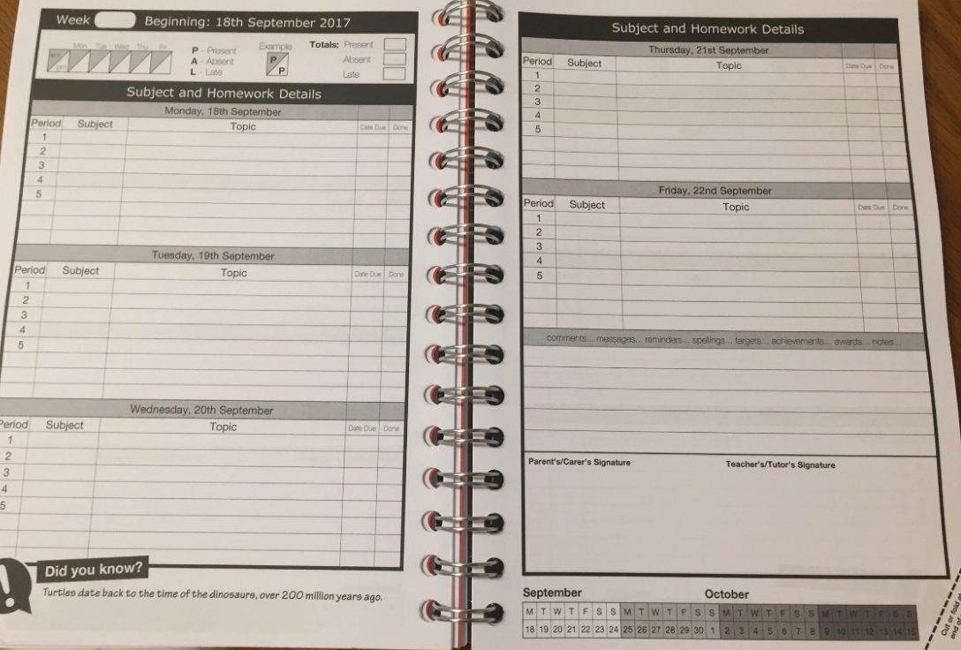
Tutor Literacy Activities- Word of the Week
Each week you will write your word of the week here in your planner.
Ensure you have your planner out at the start of every lesson and are trying to use it accurately in as many of your subjects as possible!
You will be awarded by your teacher for this. ☺

Slide 4
Word of the Week- T1A
Consolidate your understanding of the following words of the week from T1A.
Check you can remember: the definition, the word class and whether you can use it accurately in a sentence.
resilient
consent
prejudice
polyglot
liberty
inequality
equilibrium

Slide 5
Tutor Literacy Activities- Shout outs from T1A!
Used Tier 2 Vocab during lessons and tutor:
Adrian (8TE)
Liam (8FR)
Peter (8KO)
Aimee (8KO)
Josh (10BA)
Dawid (10BA)
Jean (10BA)
Matilda (9JP)
Amara (9JP)
Eoin (10KO)
Josh (10KO)
Literacy Stars of the Week:
Giancarlo (9RO)
Josie (11TE- nominated by MFL!)
Rocco (8BA- nominated by Drama!)
Remember- Harry Potter Studios Literacy trip is on Tuesday 5th July!

Slide 6
Word of the Week- T1B
Consolidate your understanding of the following words of the week from T1B.
Check you can remember: the definition, the word class and whether you can use it accurately in a sentence.
consolidate
conscience
consequence
conclude
conduct
concede
contemporary

Slide 7
Tutor Literacy Activities- Shout outs from T1B!
Used Tier 2 Vocab during lessons and tutor:
Lucy B (8KO)
Shay B (9BA)
Peter B (8KO)
Iga G (8KO) Maja J (8KO)
Joshua K (9BA)
Toby L (10BA)
Bailey M (8KO)
Jean-Baptiste (10BA)
Harry R (10BA)
Josh R (9BA)
Zofia S (8KO)
Oliver S (9BA)
Literacy Stars of the Week:
Alan and Sam (Nominated by Geography!)
Remember- Harry Potter Studios Literacy trip is on Tuesday 5th July!

